Slide 1
Association rules:
Association rules are statements that help to find patterns in seemingly unrelated data or a relational database (information repository). Easy example of such would be: If I buy milk, there is 80% probability that I will also buy yogurt"
An association rule has two parts, an antecedent (if) and a consequent (then).
An antecedent is an item found in the data.
A consequent is an item that is found in combination with the antecedent.
BA06_MODULE06_Market_Basket_Analysis

Slide 2
Association rules:
Association rules are created by analyzing data for frequent if/then patterns and using the criteria support and confidence to identify the most important relationships.
Support is an indication of how frequently the items appear in the database.
Confidence indicates the number of times the if/then statements have been found to be true.
In data mining, association rules are useful for analyzing and predicting customer behavior. They play an important part in shopping basket data analysis, product clustering, catalog design and store layout.

Slide 3
Groceries dataset provided with arules package in R :

Slide 4
Groceries dataset provided with arules package in R :
I will be using free Groceries dataset provided with rules package. It contains 9835 transactions (rows) and 169 items (columns). The aim of the analysis is to show the methods that allow to obtain certain rules within the dataset.
The most commonly found items in the dataset are: whole milk, other vegetables, rolls/buns, soda, yogurt.
Density of 0.026 means that there are 2.6% non zero cells in the matrix. Matrix has 9835 times 169 = 1662115 cells. Since 2.6% of that are non-zero cells, so 43214.99 items were purchased.
Average transaction consisted of 4.409 items, whereas only one item have been bought in 2159 transactions. Maximum number of items bought was 32.

Slide 5
Groceries dataset provided with arules package in R :

Slide 6
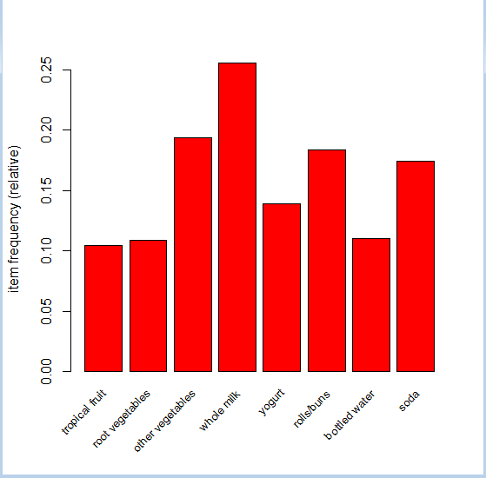
Groceries dataset provided with arules package in R :
Let us proceed to frequency plots. The more frequent the item will be in transaction the higher its bar. Moreover there are plots with different support levels. Support is the frequency of the pattern in the rule, therefore it being set to 0.1 means that the item must occur at least 10 times in 100 transactions.
itemFrequencyPlot(transactions, support=0.1, cex.names=0.8,col=2)

Slide 7
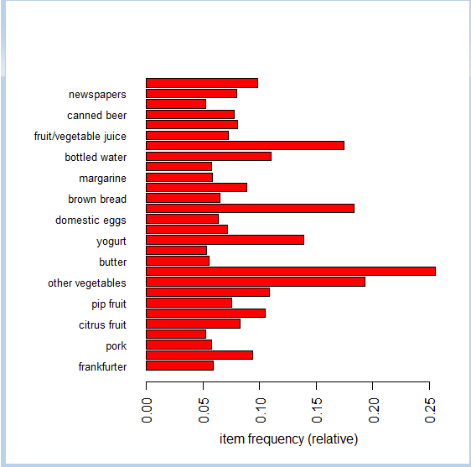
Groceries dataset provided with arules package in R :
Support is the frequency of the pattern in the rule, therefore it being set to 0.05 means that the item must occur at least 5 times in 100 transactions.
itemFrequencyPlot(transactions, support=0.05,cex.names=0.8,col=2,horiz=TRUE)

Slide 8
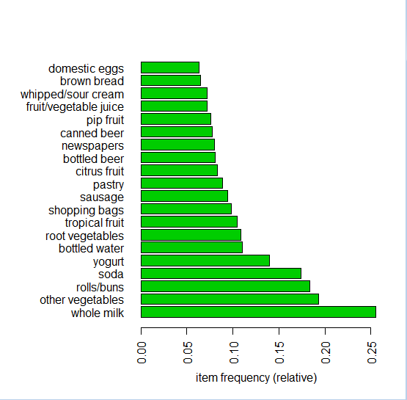
Groceries dataset provided with arules package in R :
Other way of selecting desired number of elements is to provide not support, but just the desired number. This is as presented on the third graph.
itemFrequencyPlot(transactions, topN=20,col=3,horiz=TRUE)

Slide 9
Groceries dataset provided with arules package in R :
On an average, each item set or basket contains 4 to 5 items.
In other words, basket having less than 5 items is more frequent as compare to baskets having more than 15 items.
Buyers generally come to purchase fewer items from the shop.
Support being set to .01 means that plot only includes item set having more than 1 repetition in each 100 transactions. Support less than 0.05 won’t generate significant rules and needed to be ignored for the study.

Slide 10
Business rules:
Support shows the frequency of the patterns in the rule; it is the percentage of transactions that contain both A and B,
Confidence is the strength of implication of a rule; it is the percentage of transactions that contain B if they contain A,
Support = Probability (A and B) Support = (# of transactions involving A and B) / (total # of transactions).
Confidence = Probability (A and B) = P(A) Confidence = (# of transactions involving A and B) / (total # of transactions that have A).
Expected confidence is the percentage of transactions that contain B to all transactions, i.e. Expected confidence = Probability (B)

Slide 11
Correlation analysis
The lift score meanings:
Lift = 1 meaning A and B are independent .There is no relation between A and B as far as buying pattern is concerned.
Lift > 1 meaning A and B are positively correlated .correlated.so if A Is bought then we can be positively confident that B will be bought by as many times as the lift value.
Lift < 1 meaning A and B are negatively correlated.so if A Is bought then we can be negatively confident that B will not be bought by as many times as the lift value.

Slide 12
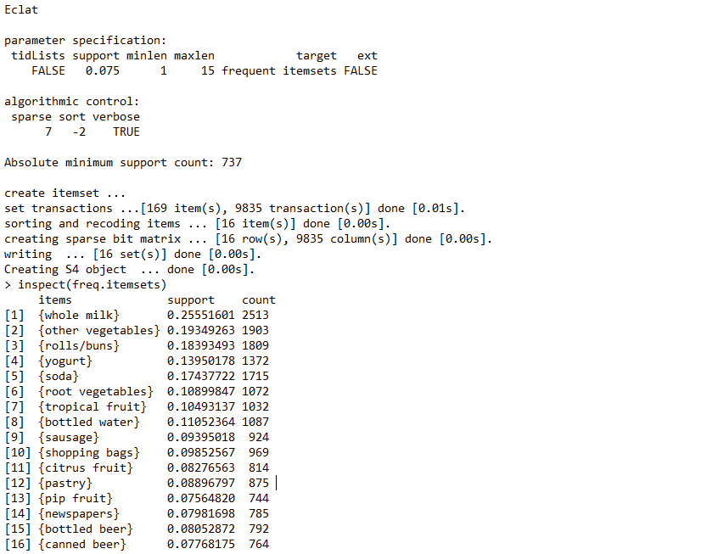
eclat algorithm - to see most frequent item sets
Firstly let us try the éclat algorithm - to see most frequent item sets. Below we will see the list of the most common items together with their individual support.
freq.itemsets <eclat(transactions, parameter=list(supp=0.075, maxlen=15))
We can conclude that Most frequent item sets correspond to the most frequent items (as there are no more than 2 items item sets.)
8/24/2020
BA06_MODULE06_Market_Basket_Analysis

Slide 13
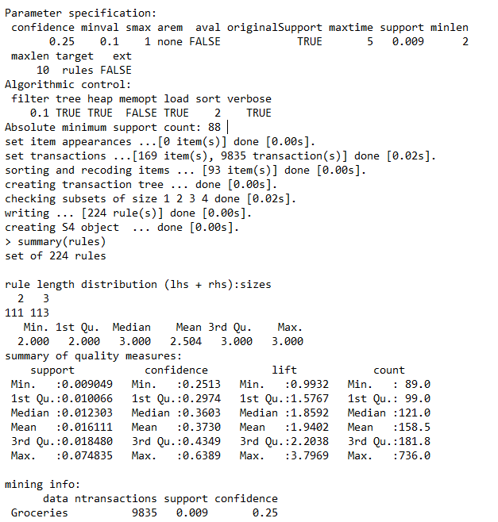
. Rules created using apriori algorithm:
Let us create rules then. Rules are created using apriori algorithm and giving minimal support and confidence of a rule.
Summary of rules will provide us with statistical information about support, confidence, lift and count of items.
We obtained a set of 224 rules, where mean support is equal to 16% and mean confidence is 37%. These are not bad values. It means that mean rule occurs in 16% transactions and its implication has 37% power. Inspect top.
rules <- apriori(Groceries, parameter = list(support = 0.009, confidence = 0.25, minlen = 2))summary(rules)
. Rules are created using apriori algorithm
8/24/2020
BA06_MODULE06_Market_Basket_Analysis

Slide 14
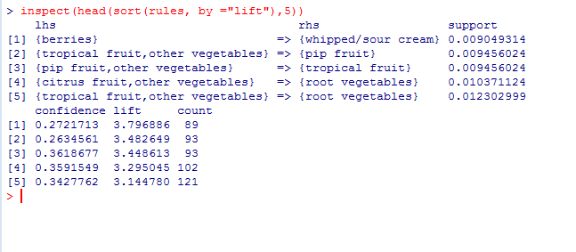
Inspect top 5 rules sorted by lift from high to low:
Above rules (sorted by lift - preference of buying B if A was bought) can be interpreted as such:
Anyone who buys citruses/tropical fruits is 3.29 and 3.14 times more likely respectively to buy root vegetables than any other client.
Anyone who buys berries is 3.7 times more likely to buy whipped/sour cream than any other client.
People like to buy berries and eat them with cream.
8/24/2020
BA06_MODULE06_Market_Basket_Analysis

Slide 15
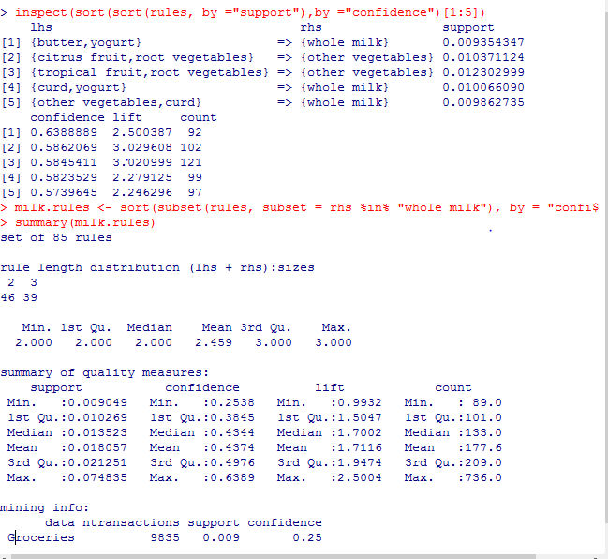
Inspect top 5 rules sorted by lift from high to low:
Let us see rules that have high support and high confidence.
There is new rule (very strong) that says that buying milk is associated with buying curd, yoghurt or butter.
8/24/2020
BA06_MODULE06_Market_Basket_Analysis

Slide 16
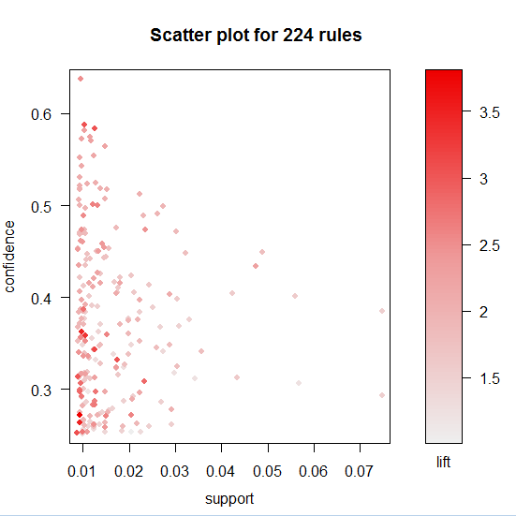
Scatter plot for 224 rules:
we can plot the rules in support and confidence axes and colour them with lift values.
Most of the rules have small values of support i.e. around 0.01, but confidence varies from 0.6 up to 0.3.
The reddier the point meaning higher is the lift and so then more likely is the rule to happen.
8/24/2020
BA06_MODULE06_Market_Basket_Analysis

Slide 17
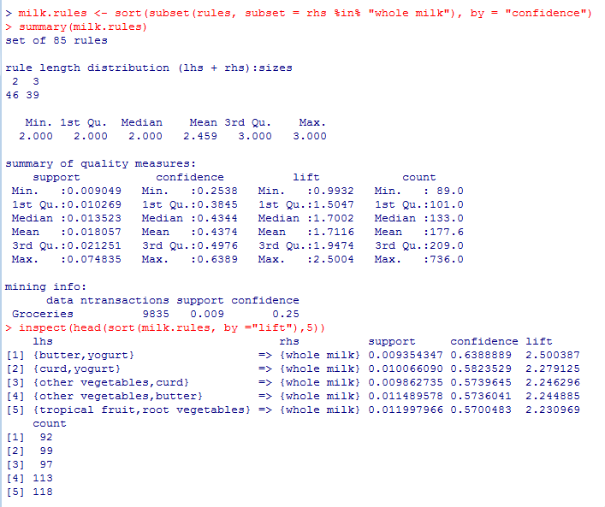
Induction:
Below analyses depend on choosing one product and checking which products it implies or by which products it is implied.
Right hand side we have milk and we can see that if a customer buys butter, yoghurt or curd, yoghurt or other vegetables, curd or other vegetables, butter or tropical fruits and root vegetables then we are more confident that the customer will buy whole milk as well.
The figure shown adjacent shows the top five lift given the condition that if a customer buy items on the l.h.s we are confident that customer will then buy whole milk.
8/24/2020
BA06_MODULE06_Market_Basket_Analysis

Slide 18
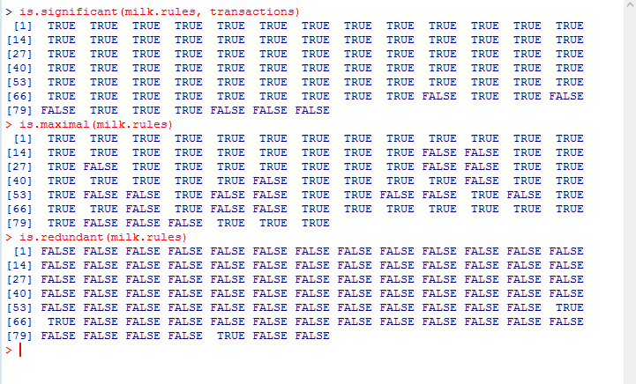
Milk.rules:
We can find that most of the milk.rules which is subset of the 224 rules which comes to 85 rules are significant.
also maximal condition getting satisfied for milk.rules.
Most of the subset of the rules so formed are non redundant as well.
8/24/2020
BA06_MODULE06_Market_Basket_Analysis

Slide 19
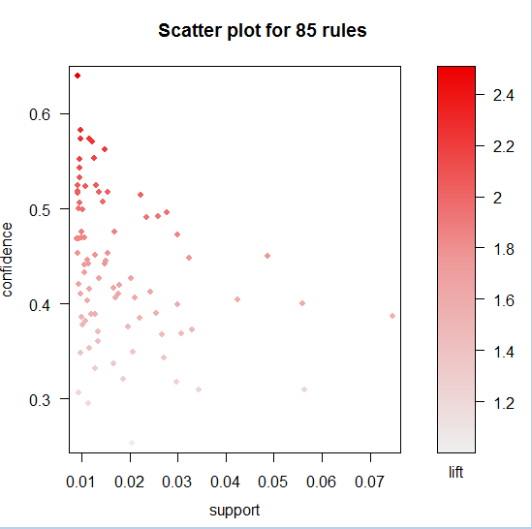
Scatter plot for Milk.rules:
we can plot the rules in support and confidence axes and colour them with lift values.
Most of the rules have small values of support i.e. around 0.01, but confidence varies from 0.6 up to 0.4 for most of the rules. Here we have framed subset of the rules under the condition that we are confident that customer will then buy whole milk if say customer buys certain predefined item set.
The reddier the point meaning higher is the lift and so then more likely is the rule to happen.
8/24/2020
BA06_MODULE06_Market_Basket_Analysis

Slide 20
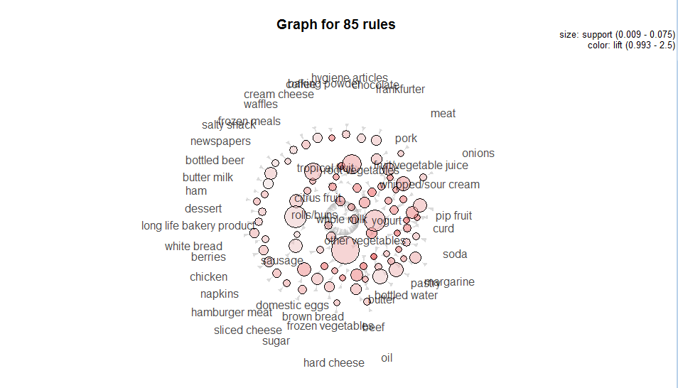
Visualization for milk. Rules using method="graph“:
The reddier the circle the more probable is the client to buy two of those items than any other items
The bigger the circle the more probable is the client to buy two of those items.
Moreover the arrow points to the direction of a possible basket rule.
More complicated conclusions can be drawn from the milk.rules plot.
yoghurt ,other vegetables, tropical fruits, root vegetables are the mostly supported additional product for milk.
8/24/2020
BA06_MODULE06_Market_Basket_Analysis

Slide 21
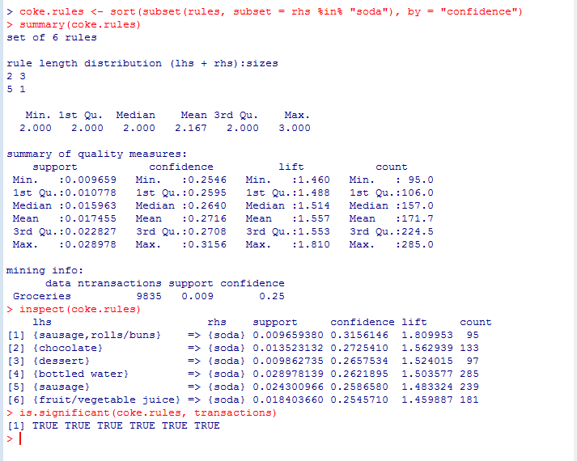
coke.rules:
Below analyses depend on choosing one product and checking which products it implies or by which products it is implied.
Right hand side we have soda and we can see that if a customer buys sausage, rolls/bun, chocolate, or dessert, or bottled water or sausage only or fruit/vegetable juice then we are more confident that the customer will buy soda as well.
The figure shown adjacent shows all of the coke.rules given the condition that if a customer buy items on the l.h.s we are confident that customer will then buy soda.
8/24/2020
BA06_MODULE06_Market_Basket_Analysis

Slide 22
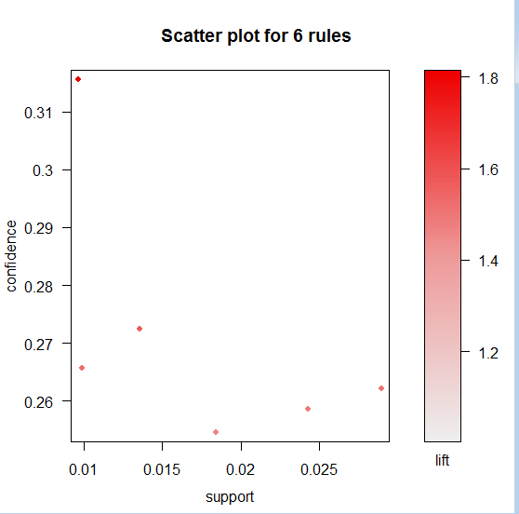
Scatter plot for coke.rules:
we can plot the rules in support and confidence axes and colour them with lift values.
Two of the six rules have small values of support i.e. around 0.01, but confidence varies from 0.31 up to 0.26. Here we have framed subset of the rules under the condition that we are confident that customer will then buy soda if say customer buys certain predefined item set.
The reddier the point meaning higher is the lift and so then more likely is the rule to happen.
8/24/2020
BA06_MODULE06_Market_Basket_Analysis

Slide 23
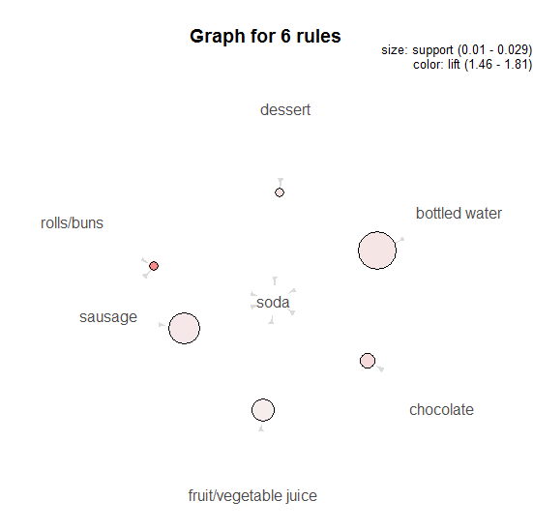
Visualization for coke.rules using method="graph“:
The reddier the circle the more probable is the client to buy two of those items than any other items
Sausage with soda is the second most import rule that can be formed.
Therefore in case of Coke, we can notice bottled water and soda as the rule with highest support.
Moreover the arrow points to the direction of a possible basket rule.
The bigger the circle the more probable is the client to buy two of those items.
8/24/2020
BA06_MODULE06_Market_Basket_Analysis

Slide 24
Summary for milk.rules and coke.rules:
Analysis was aimed to see what makes people buy milk (what products to be exact).
To do se we should choose subset of rules that has whole milk (or soda) in right hand side of a rule.
It turns out that most popular baskets are curd, yoghurt or fruits and vegetables.
Seems like the most popular one-week ahead groceries we do.
On the other hand it seems that soda is mostly bought with either sweets (chocolate) or with beverages/meat.
Most of the rules are significant (Fisher’s exact test) apart from some of the least confident rules of milk buying.
We can also see on the scatter plot of rules for milk that the higher the confidence the higher lift, which was not observed before. It also occurs on Coke rules plot, but is not that visible.

Slide 25
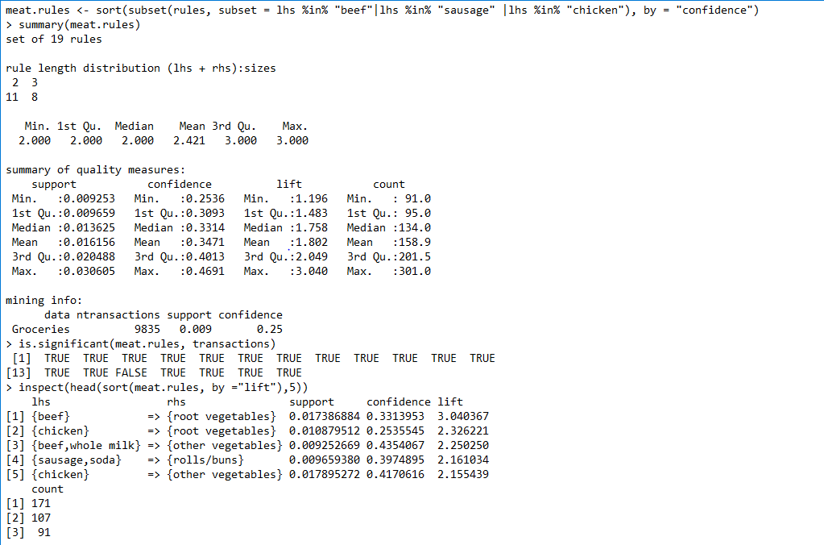
meat. Rules:
Below analyses depend on choosing one product and checking which products it implies or by which products it is implied.
left hand side we have meat and we can see that if a customer buys beef or chicken we are 3.04 times 2.32 times confident respectively that he will buy root vegetables. We can draw such similar inferences such as that on the l.h.s. customer always buys meat as an item.
The figure shown adjacent shows the top five lift given the condition that if a customer buy meat on the l.h.s we are confident that customer will then buy items as shown on R.H.S.
8/24/2020
BA06_MODULE06_Market_Basket_Analysis

Slide 26
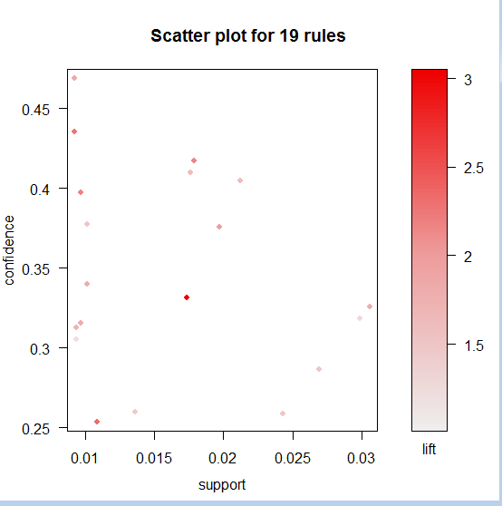
Scatter plot for meat. Rules:
we can plot the rules in support and confidence axes and colour them with lift values.
Many of the rules have small values of support i.e. around 0.01, but confidence varies from 0.45 up to 0.25 for many of the rules. Here we have framed subset of the rules under the condition that if customer buys meat then we are confident that customer will buy certain item set as listed in summary(meat. Rules).
The reddier the point meaning higher is the lift and so then more likely is the rule to happen.
8/24/2020
BA06_MODULE06_Market_Basket_Analysis

Slide 27
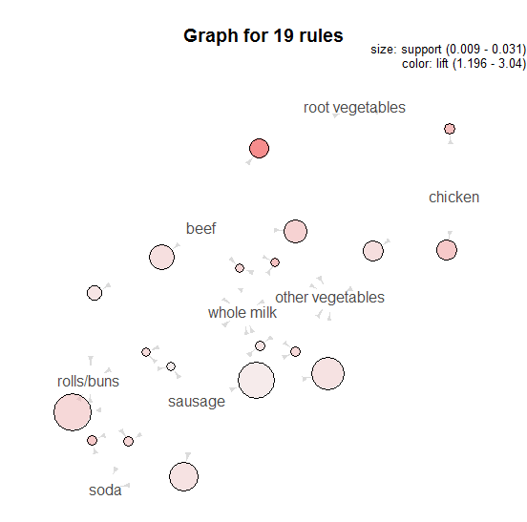
Visualization for meat. Rules using method="graph“:
The reddier the circle the more probable is the client to buy two of those items than any other items.
The bigger the circle the more probable is the client to buy two of those items.
Moreover the arrow points to the direction of a possible basket rule.
Sausage, rolls/buns, soda are the mostly supported additional product for beef and chicken.
Root vegetable is the one with the highest lift values.however,the support for it is comparatively smaller. Other vegetables also seems to be there in contention though it is not as strong as root vegetables.
8/24/2020
BA06_MODULE06_Market_Basket_Analysis

Slide 28
Summary for meat. Rules :
In case of meat, we search whether meats like: beef, chicken (poultry) or sausage show up in the left hand sides of rules.
Let’s see what people buy after they have put meat (sausage or beef) to the basket.
It turns out that the most popular option associated with meat is milk!
It is a little bit confusing, because only in lift column we see how popular option is.
The real winner here are root vegetables that are 3 times more likely to be put into the basket than other products.
Rest of the products are just regular grocery stuff.

Slide 29
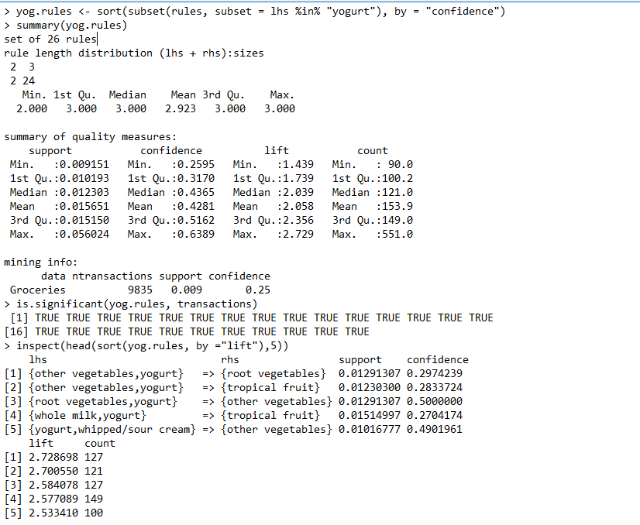
yogurt. Rules:
Below analyses depend on choosing one product and checking which products it implies or by which products it is implied.
left hand side we have yoghurt and we can see that if a customer buys yoghurt in combination with some other item in L.H.S. We are confident that he will buy item set as depicted in summary(yog.rules)
The figure shown adjacent shows the top five lift given the condition that if a customer buy yoghurt on the l.h.s we are confident that customer will then buy items as shown on R.H.S.
Most of the times someone buys yogurt he will also put milk or vegetables into his basket - with greater correlation to ‘other vegetables’. There is not much variation, nothing changes with the lowering confidence.
8/24/2020
BA06_MODULE06_Market_Basket_Analysis

Slide 30
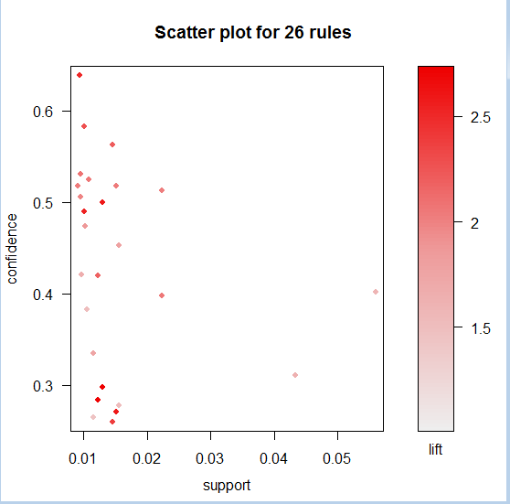
Scatter plot for yogurt. Rules:
we can plot the rules in support and confidence axes and colour them with lift values.
Many of the rules have small values of support i.e. around 0.01, but confidence varies from 0.6 up to 0.3 for many of the rules. Here we have framed subset of the rules under the condition that if customer buys yoghurt then we are confident that customer will buy certain item set as listed in summary(yog. Rules).
The reddier the point meaning higher is the lift and so then more likely is the rule to happen.
8/24/2020
BA06_MODULE06_Market_Basket_Analysis

Slide 31
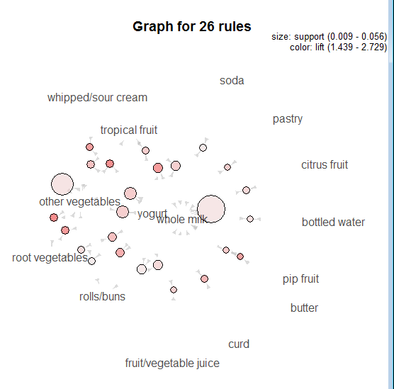
Visualization for yoghurt. Rules using method="graph“:
Whole milk ,other vegetables, are the mostly supported additional product for yoghurt.
Tropical fruits and root vegetables also seem to be in contention though their support size is needed to improve.
8/24/2020
BA06_MODULE06_Market_Basket_Analysis

Slide 32
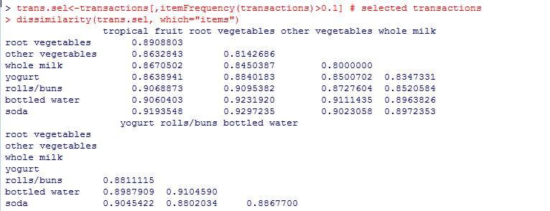
Jaccard Index:
Jaccard Index: It is the representation of how much likely are two items to be bought together.
Because I have picked such high minimal frequency we have not much items, but moreover Jaccard Index seems to have high values telling us that most of those products do not overlap.
Such an array as presented above tells that the higher the values of Jaccard Index the more likely are two products to be in the same transaction.
8/24/2020
BA06_MODULE06_Market_Basket_Analysis

Slide 33
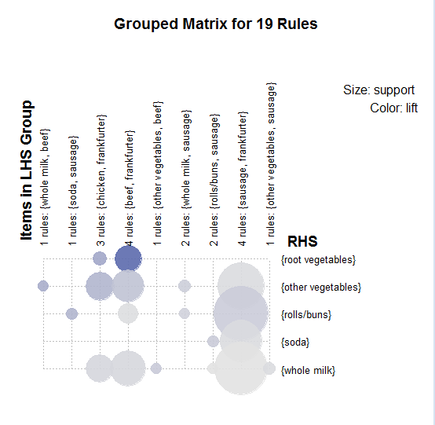
Advanced graphics:
plot(meat.rules, method="grouped", measure="support", control=list(col=sequential_hcl(100)))
can see that for beef and root vegetables, the lift is quite high and support is also quite significant.
For sausage support is quite significant for root vegetables, other vegetables,rools bun, soda and whole milk. However lift is not that good.
8/24/2020
BA06_MODULE06_Market_Basket_Analysis

Slide 34
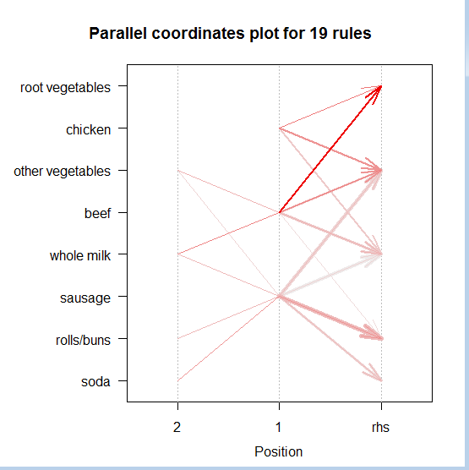
Advanced graphics:
plot(meat.rules, method="paracoord", control=list(reorder=TRUE))
We can even show dependencies with parallel coordinates plot. We can see that the mostly red arrow (each of them represents one rule) connects beef and root vegetables.
Moreover most of the arrows connect sausage on the first position, as previously stated.
8/24/2020
BA06_MODULE06_Market_Basket_Analysis

Slide 35
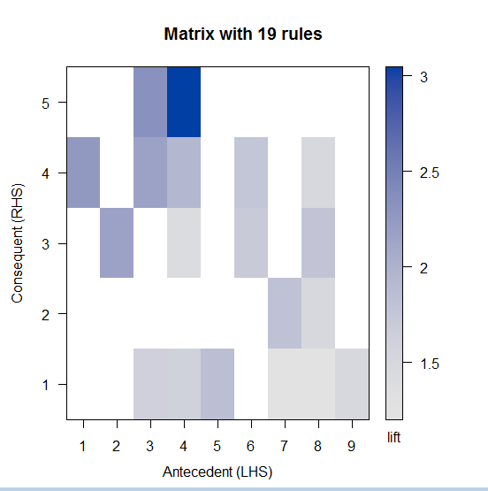
Advanced graphics:
plot(meat.rules, method="matrix", measure=c("support","confidence"), control=list(col=sequential_hcl(200)))
Itemsets in Antecedent (LHS)
[1] "{beef,whole milk}" "{sausage,soda}" "{chicken}"
[4] "{beef}" "{beef,other vegetables}" "{sausage,whole milk}"
[7] "{sausage,rolls/buns}" "{sausage}" "{sausage,other vegetables}"
Itemsets in Consequent (RHS)
[1] "{whole milk}" "{soda}" "{rolls/buns}" "{other vegetables}"
[5] "{root vegetables}"
8/24/2020
BA06_MODULE06_Market_Basket_Analysis

Slide 36
Advanced graphics:
Let’s present the ruleset for meat but in a matrix form. Each of the matrix cells can have different blue shade depending on the lift value.
Numbers on the axes are corresponding to the items listed before the matrix.
For example the most blue cell corresponds to the rule {beef} -> {root vegetables}, hence (as previously mentioned) root vegetables are most likely to be bought with beef. On the second place is the chicken and for the rest of antecedent items there is no significant lift at all (it is too small to be presented on the graph).
Such a graph is only confirmation fo the conclusions drawn before, but in a simplier form.
8/24/2020
BA06_MODULE06_Market_Basket_Analysis

Slide 37
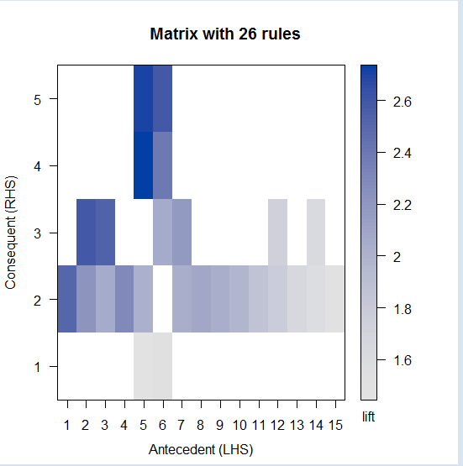
Advanced graphics:
8/24/2020
BA06_MODULE06_Market_Basket_Analysis

Slide 38
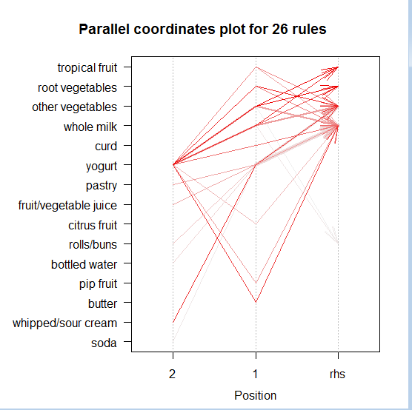
Advanced graphics:
Whole milk ,other vegetables, root vegetables,tropical fruits are the mostly supported additional product for yoghurt.
Moreover most of the arrows connect yoghurt on the first position, as previously stated. Also whipped/sour cream bought along with yoghurt for most of the times.
8/24/2020
BA06_MODULE06_Market_Basket_Analysis

Slide 39
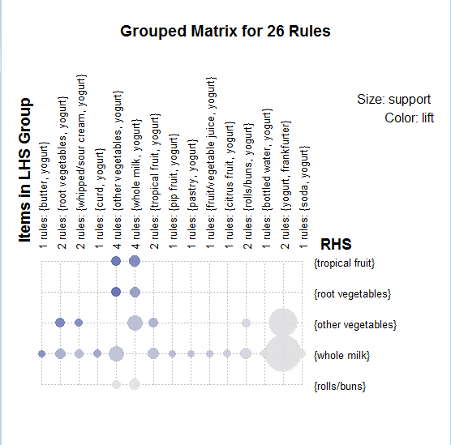
Advanced graphics:
plot(meat.rules, method="grouped", measure="support", control=list(col=sequential_hcl(100)))
can see that for tropical fruits and other vegetables, yoghurt and whole milk, yoghurt the lift is quite high.
For root vegetable and other vegetables, yoghurt lift is quite high. For other vegetables, root vegetables, yoghurt lift is quite high.
For other items support is significant but lift is not very much notable.
8/24/2020
BA06_MODULE06_Market_Basket_Analysis

Slide 40
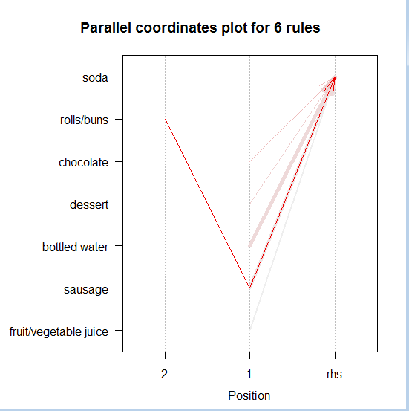
Advanced graphics:
rolls\bun bought along with soda with higher lift.
Moreover the arrows connect chocolate, dessert and boiled water on the first position.
8/24/2020
BA06_MODULE06_Market_Basket_Analysis

Slide 41
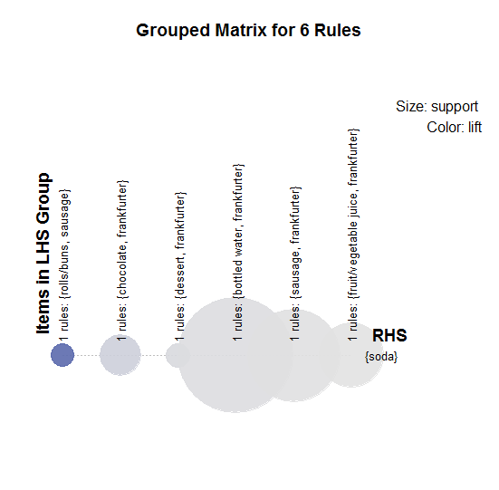
Advanced graphics:
rolls\bun, sausage bought along with soda with higher lift.
There are other items in LHS whose support is bigger but lift is comparatively lower for them.
8/24/2020
BA06_MODULE06_Market_Basket_Analysis

Slide 42
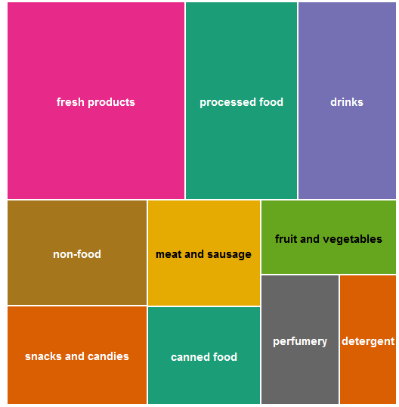
Tree map: :
If we want to look into data deeper, we can create interesting plots that show us how many products of each type are available to buy in the grocery store.
8/24/2020
BA06_MODULE06_Market_Basket_Analysis

Slide 43
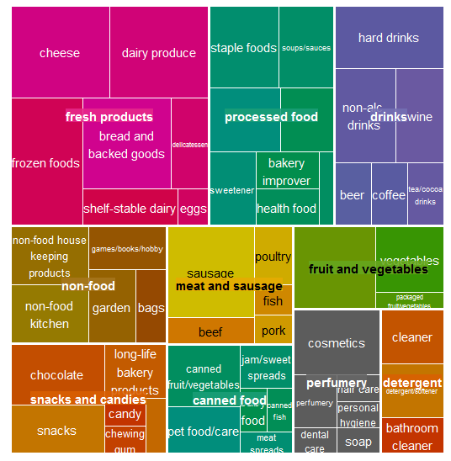
Tree map: :
Each of these charts have different level of depth. First only shows the bigger group names (like aisles in the shop).
Second shows deeper segmentation intro product types (for example within aisle).
8/24/2020
BA06_MODULE06_Market_Basket_Analysis

Slide 44
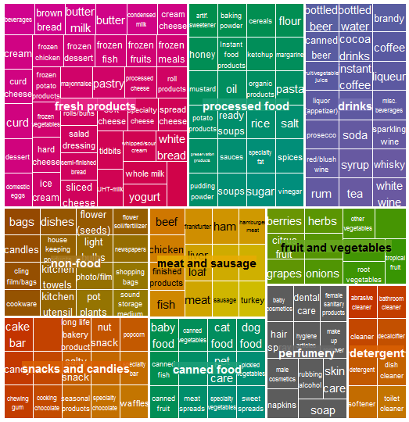
Tree map: :
Here I made three tree maps, including one with deeper segmentation that present which products are on the lists of the shop. Moreover it can explain why there are so many connections with milk and fresh products, whereas just a little with coke.
The last chart presents each of the products available - it does give us less information than the second one.
8/24/2020
BA06_MODULE06_Market_Basket_Analysis

Slide 45
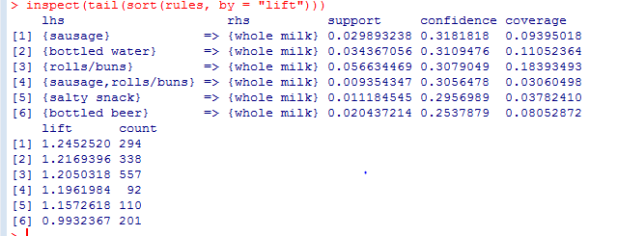
Less than likely? - Lift < 1: :
Interesting part of the study would be checking for items that are less than likely to be bought together. These would be described by lift < 1.
There is only one item in our rules set, that has lift less than 1. It is a connection between whole milk and bottled beer. It means that we are less likely to buy milk than any other product in dataset, while already having beer in basket.
8/24/2020
BA06_MODULE06_Market_Basket_Analysis

